Slide 1
Objectives
Components of the database environment
Database users
Functions of DBA
Roles in the Database Environment
Some common terms

Slide 2
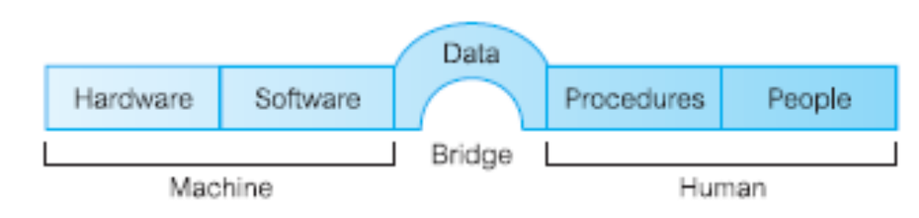
Components of the Database Environment

Slide 3
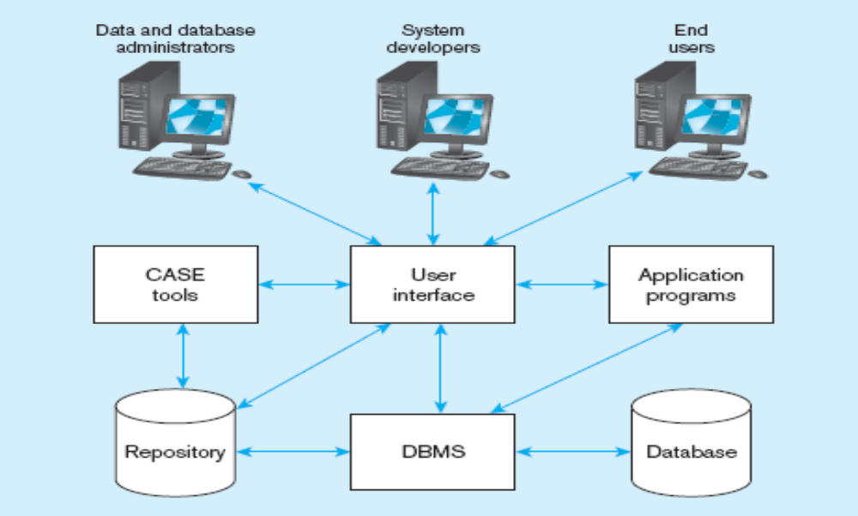
Components of the Database Environment

Slide 4
Components of the
Database Environment
CASE Tools–computer-aided software engineering
Software tools that provide automated support for some portion of the systems development process.
Are automated tools to design database and application programs.
These tools help with creation of data models
Repository–centralized storehouse of metadata
Database Management System (DBMS) –software for managing the database
Database–storehouse of the data

Slide 5
Application Programs–software using the data
User Interface–text and graphical displays to users
Data Administrators: are persons who are responsible for the overall management of data resources in an organization.
Database Administrators–personnel responsible for physical database design and for managing technical issues in the database environment.

Slide 6
System Developers– are persons who design new application programs. System developers often use CASE tools for system requirements analysis and program design.
End Users
are persons who add, delete and modify data in the database and who request or receive information from it.
All user interactions with the database must be routed through the DBMS.
people who use the applications and databases

Slide 7
Database Users:
Application Programmers
End Users
  Naïve
  Sophisticated
Database Administrator (DBA)
A person who has central control over data and programs that access this data
© Virtual University of Pakistan

Slide 8
Functions of DBA are:
Schema definition
Granting data access
Routine Maintenance
Backups
© Virtual University of Pakistan

Slide 9
Roles in the Database Environment
Data Administrator (DA)
Database Administrator (DBA)
Database Designers
Application Programmers
End Users (native and sophisticated)
19

Slide 10
Common Terms
Data: Facts concerning things, such as people, objects, or events
Information: Data that have been processed and presented in a form suitable for human interpretation
Metadata: data that describes the properties and context of user data including data types, field sizes, allowable values
© Virtual University of Pakistan

Slide 11
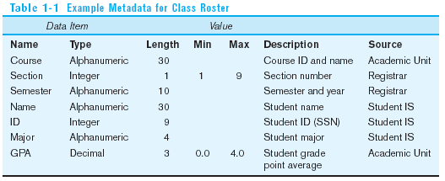
Descriptions of the properties or characteristics of the data, including data types, field sizes, allowable values, and data context

